Slide 1
Wildfire Risk Predictor Project
Sicheng Chen, Alexander Kamperin,
Ahhyun Cho, and William Camacho (SAAW)

Slide 2

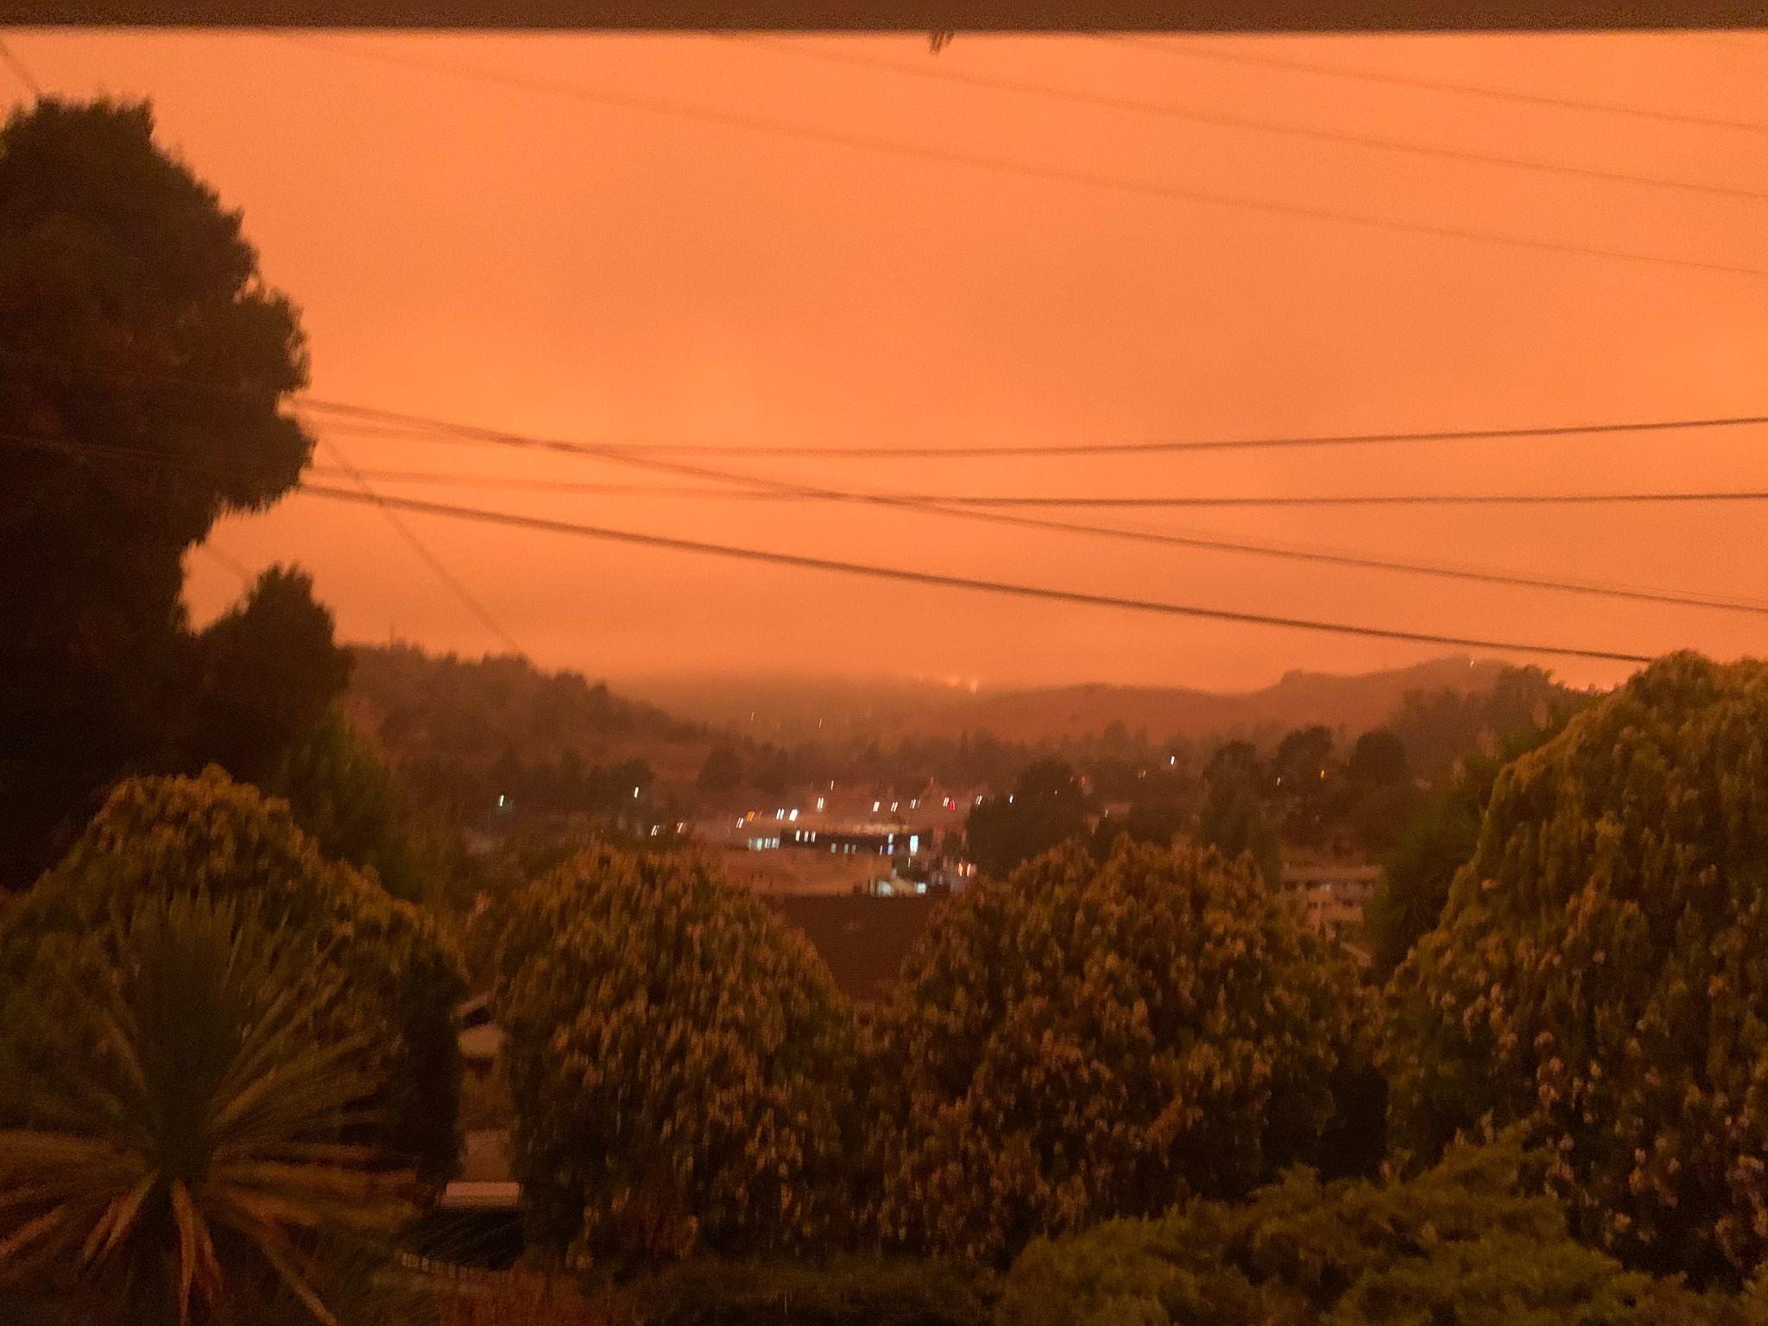
The Issue
New York City, June 2023
Marin County, California, October 2020
Notes:
"Did you know that in 2020, wildfires burned over 10 million acres in the United States alone, equivalent to the entire state of Maryland?"

Slide 3
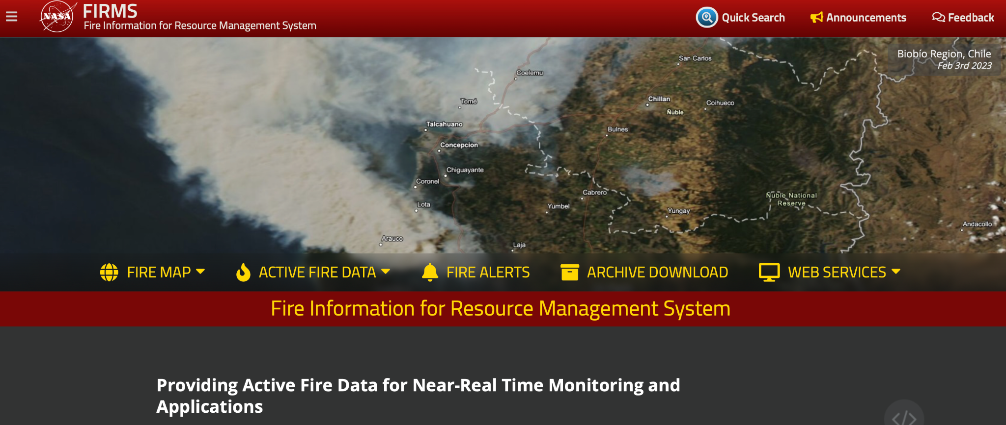
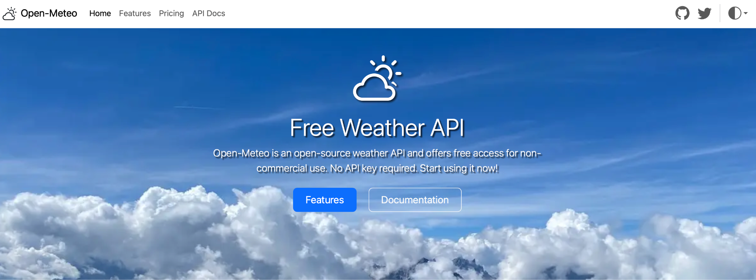

Data Acquisition and Processing
Fire data: https://firms.modaps.eosdis.nasa.gov/data/country/zips/modis
Weather data: https://archive-api.open-meteo.com/v1/archive
Processure：
Get historical fire data
Divide the area we are studying, California/Oregon/British Columbia (West coast, lots of fires), into grids, and get all the combinations of latitudes and longitudes as the coordinates of the crosses of the grids, in total 3600 locations for each dataset.
Input the 3600 combinations of latitudes and longitudes to the weather API 200 a time (limit for url) for 18 times, then save the response for each time to sql database and concatenate the 18 small tables to a single large table. Now we have weather data (such as temperature, precipitation, wind etc) for every single combination of location for every single date from 2017 to 2022. Nearly 8 million data points.
Round the latitudes and longitudes in fire data to the nearest latitude and longitude in weather data, and then merge the two DataFrames to form a DataFrame that contains both fire and weather value.

Slide 4
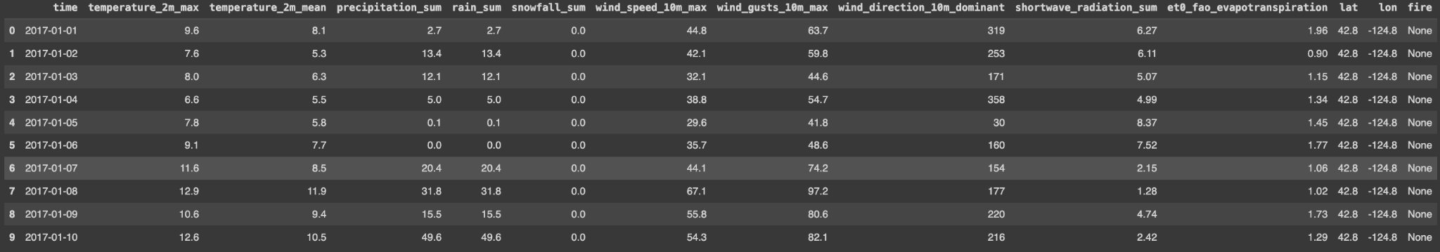
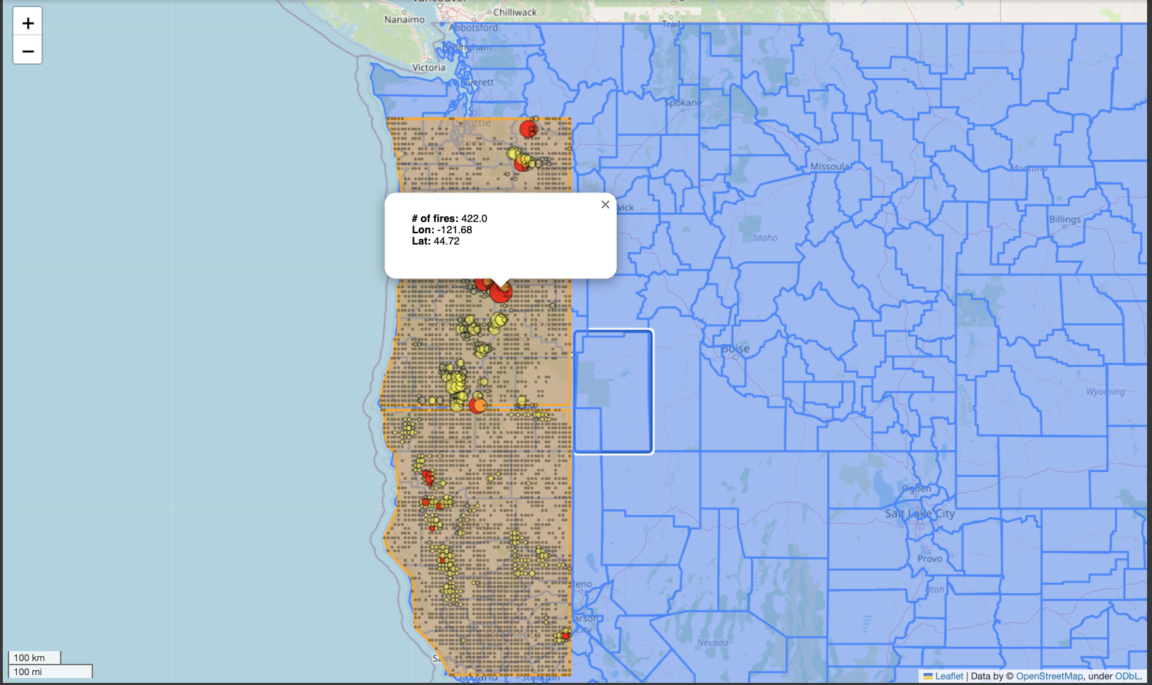
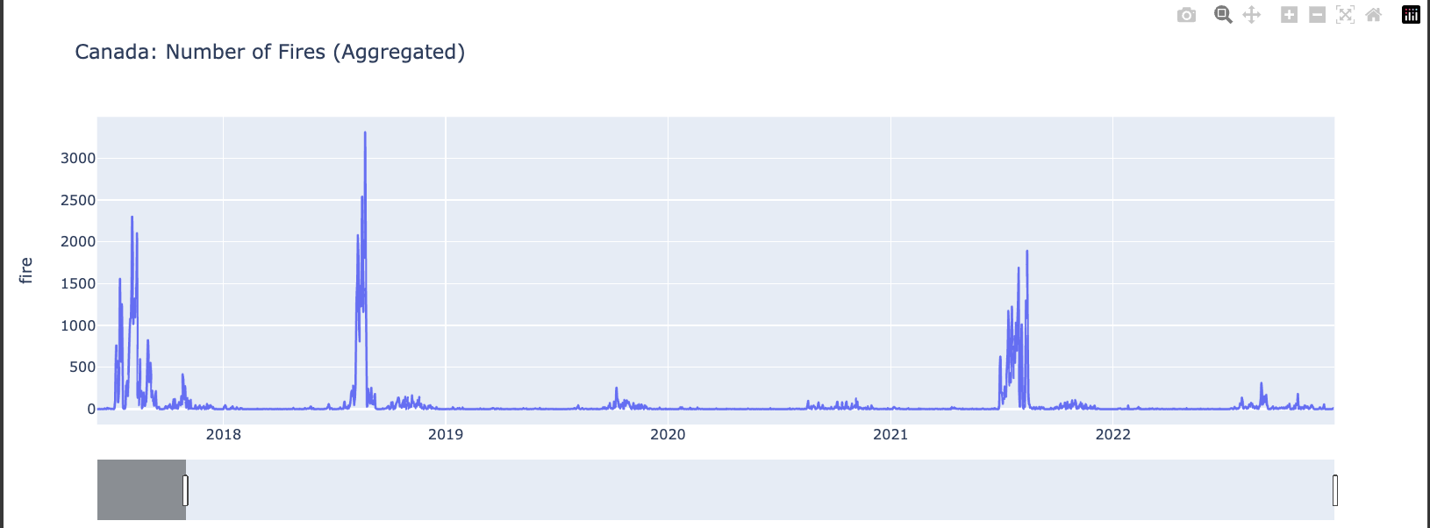
Data Visualization and Data Analytics

Slide 5
Training Machine Learning Model
The DataFrame: 2000+ days, 3600 combinations of latitude and longitude
-> nearly 8 million rows with more than 7 million instances of “no-fire” and 10000-20000 instances of “fire”
Train-test split: 2017-2021 as train; 2022 as test (unique train-test split method specific for forecasting future)
Ordinary train-test split method may use the data in the future to predict the past, but the pattern of data may change. Although the ROC curve of ordinary train-test split is better, we cannot trust it because in reality we cannot use fire in May to forecast fire in April
Make fire binary: fire>=1→1; fire=0→0. If we do not do this, our result will be the expected number of fires according to the machine learning model, rather than the probability of having fire.

Slide 6
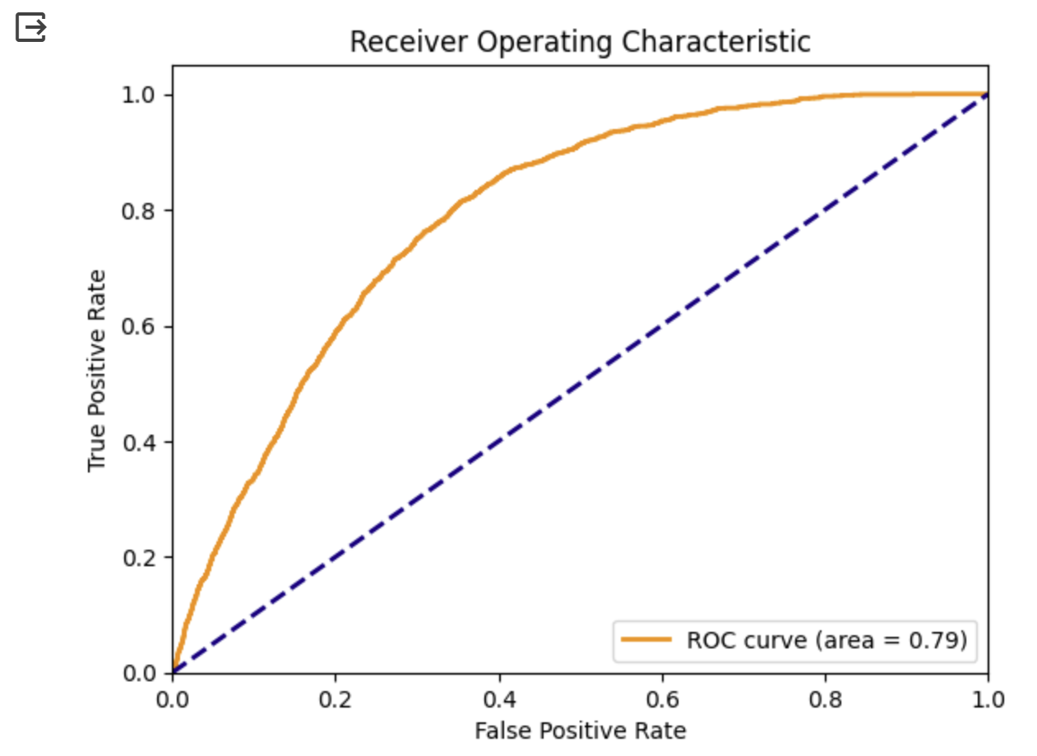
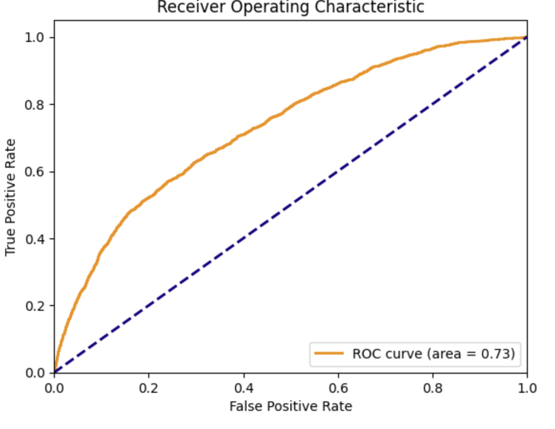
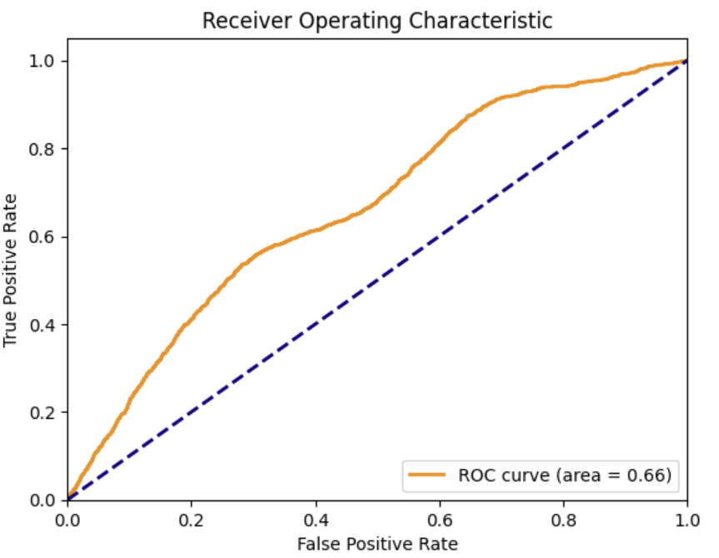
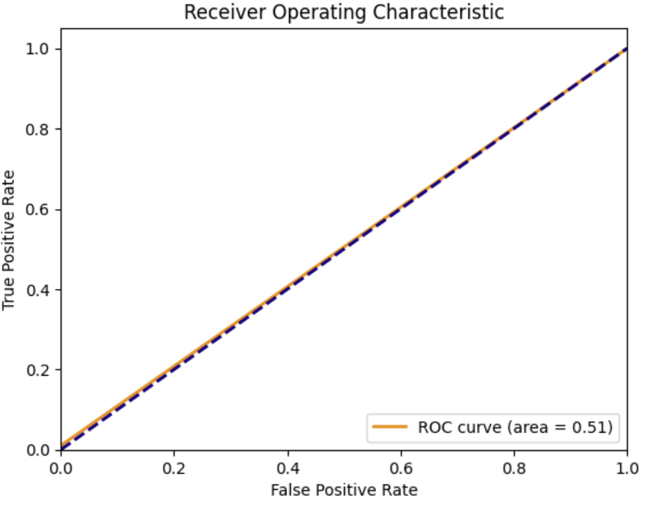
Training Machine Learning Model
Model performance: measured by the area under the ROC curve
Predict today’s possibility of fire of a particular location by obtaining the weather information and use model.predict_proba
>
≥
Gaussian
Naive Bayes
≥
XGboost
Logistic regression
Decision Tree

Slide 7
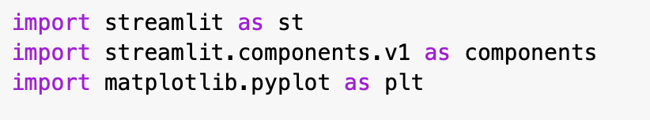
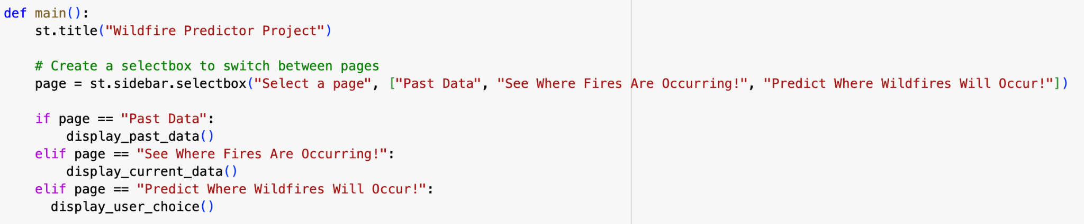
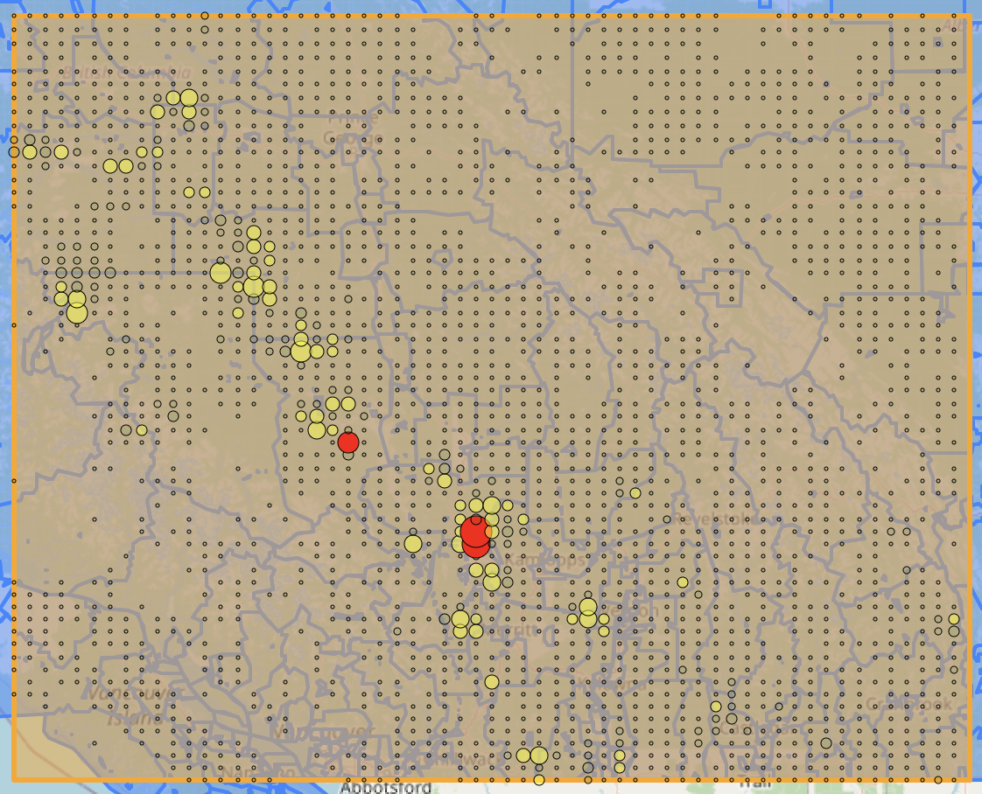
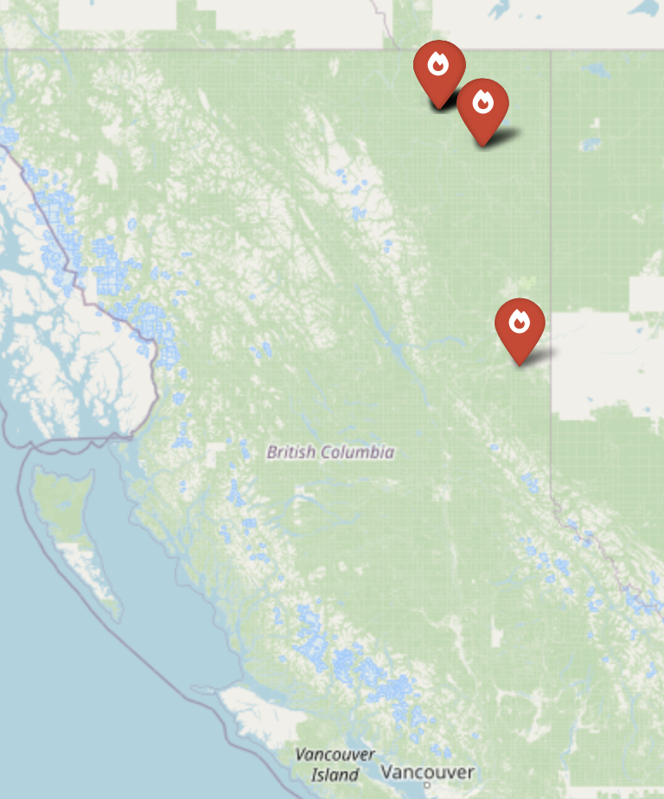
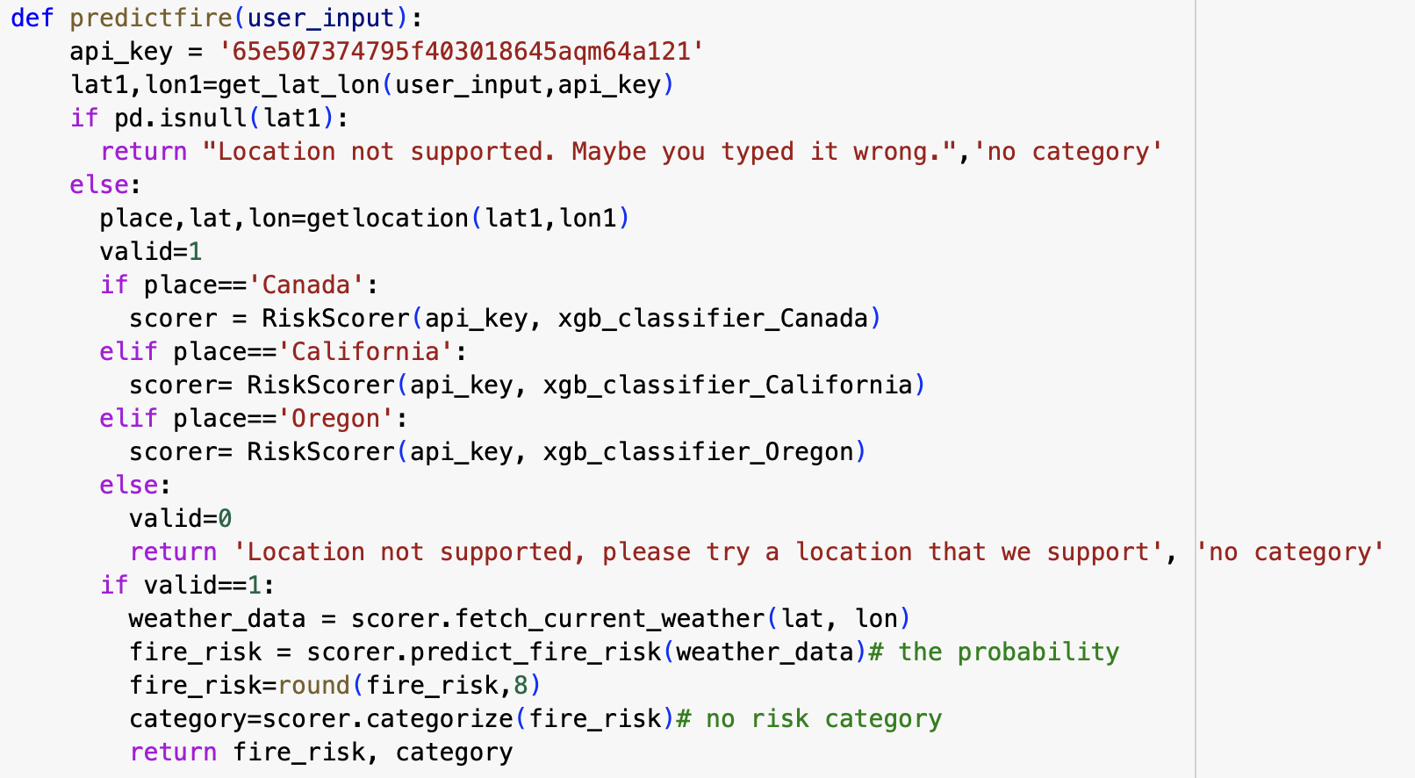
Front-end: Streamlit
Notes:
Portland: 45.523064, -122.676483

Slide 8
Next Steps…
Machine Learning Improvements
Number of fires in the last year and effects (Soil Condition, Changed Microclimate, etc.)
Add fire intensity and growth rate to the output target variables of the XGBoost Predictive model
Becoming more specific with locations, utilizing coordinates rounded to the 3rd decimal place instead of the 1st (need more computing power)
Future Improvements General
Have an aggregate forecast for weather, 1-7 day future lag
Expanding regions, using similar climates to test
Correlation between human population density on number of fire occurrences
Layering electrical infrastructure maps on fire occurrences
Using satellite imagery to assess topography
Use GenVision to assess different trees and their flammability
Nearby fire proximity and wind gusts, using vectorization
Wildfire Proximity Vector Risk:
d: Distance from the fire to the location (km)
θ: Angle between the wind direction and the line connecting the fire to the location (degrees)
v: Wind gust speed (km/h)
Wind Influence
W=cos⁡(θ)
Adjusted Wind Influence Factor
W′=W×v
Distance Factor
D=1/d
Fire Risk Index
F=W′×D
Notes:
Future Improvements ML
Features:
Number of fires in the last year (factors like Fuel Regeneration, Soil Condition, Changed Microclimate due to less trees, Presence of Invasive Species, Ongoing Drought Conditions come into play)
Add fire intensity and growth rate to the output target variables of the XGBoost Predictor model
Correlation between human population density on number of fire occurrences
Layering electrical infrastructure maps on fire occurrences
Becoming more specific with locations, utilizing coordinates rounded to the 3rd decimal place instead of the 1st (need more computing power).
Future Improvements General
Have an aggregate forecast for weather, 1-7 day future lag
Expanding regions, using similar climates to test (Norcal similar to parts of the Mediterranean basin)
Using satellite imagery to assess topography (what’s more flammable, likelihood of spreading and how quickly)
Use GenVision to assess different trees and their flammability
Nearby fire proximity and wind gusts, using vectorization

Slide 9
Appendix:
Some difficulties we have encountered:
1. Availability of weather data: the api only allows limited amount of calls each hour
2. Limited RAM space of colab notebook: collapse when saving data to database and when training models
Codes and explanations: https://docs.google.com/document/d/1owsLf6FAtR76DoPqG53icwJ9COJrowktvcfPmpJz0pY/edit?usp=sharing
https://docs.google.com/document/d/1gwcJenByaW_DgmhkdpeA51S_90ksZjPJ_Ns9F83PFWI/edit?usp=sharing

